Slide 1
₿
Bitcoin Real-Time
Data Plotter
Python Semester Project
Raul Ronquillo

Slide 2
Project Overview
📡
📊
📈
Live API Polling
Live Data Loop
Animated Chart
Pulls real-time BTC spot price every second from Coinbase's public REST API using the requests library.
get_btc_price() is called every second, pulling a fresh price and appending it with a timestamp to the dataset
Uses matplotlib FuncAnimation to render a live-updating line chart of BTC price over time.

Slide 3
What I Built
🌐 Connected to real-world REST API to fetch live Bitcoin prices
🛡️ Handled API errors using try/except
📉 Built a live-updating chart using FuncAnimation
🔁 Designed a continuous data-collection loop

Slide 4
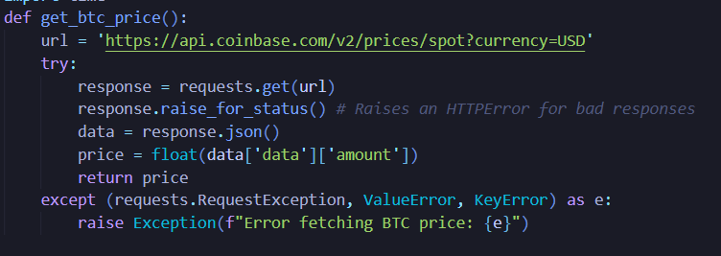
Data Collection • BTC_Data.py
Used the code from assignment 12
Could have used CryptoCompare
Uses Coinbase REST API to fetch data
Returns a float to plug directly into the plotter

Slide 5
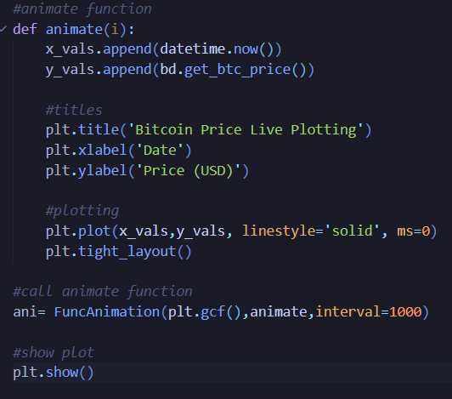
Live Plotting • FuncAnimation
⏱ interval=1000
Calls animate() every 1000 ms, fetching a fresh price from the API each tick.
📋 Append strategy
x_vals and y_vals grow with each call. matplotlib re-plots the full history every frame.
🎨 seaborn-v0_8 style
Applies a clean grid aesthetic without requiring seaborn installed separately.

